Slide 1

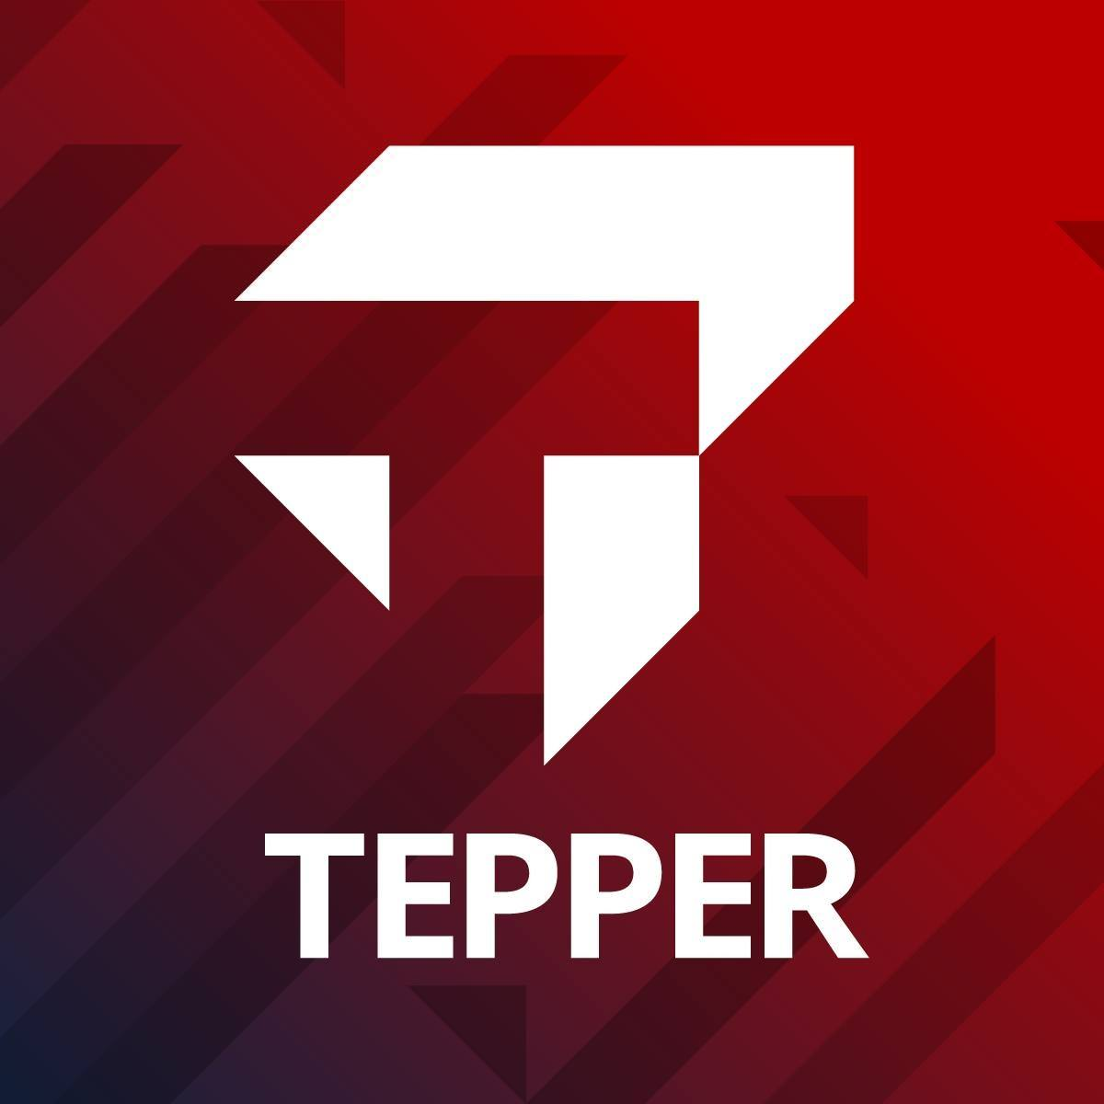
Presentation 2023
Tepper
HelpBot

Slide 2

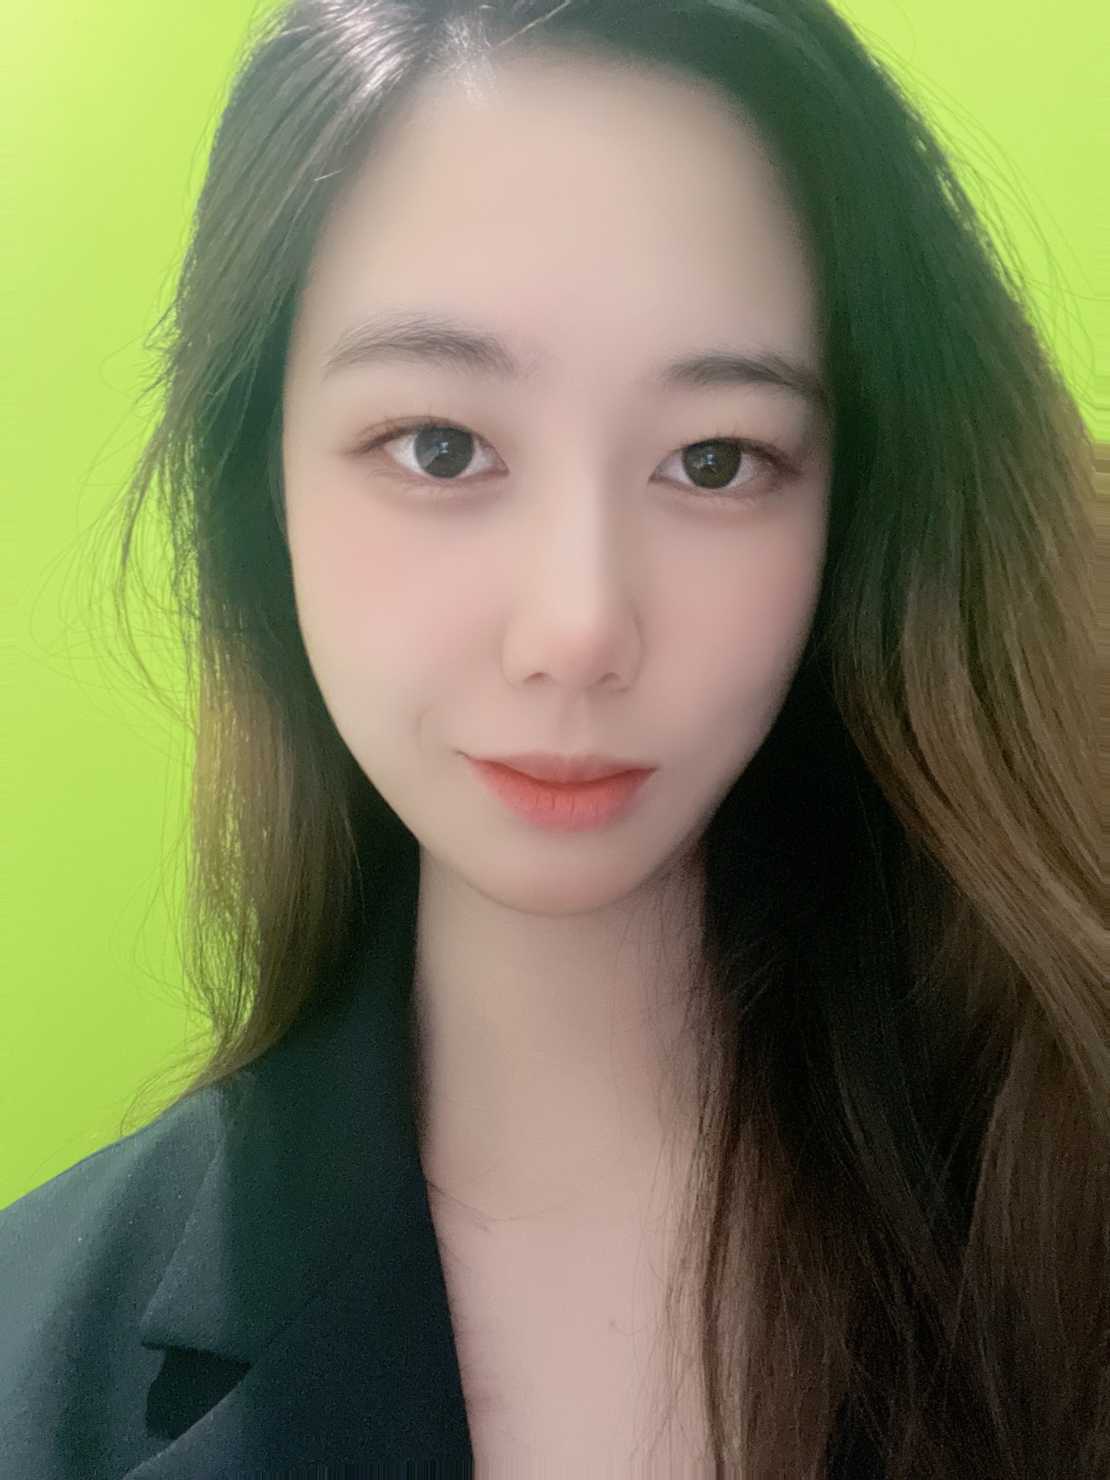
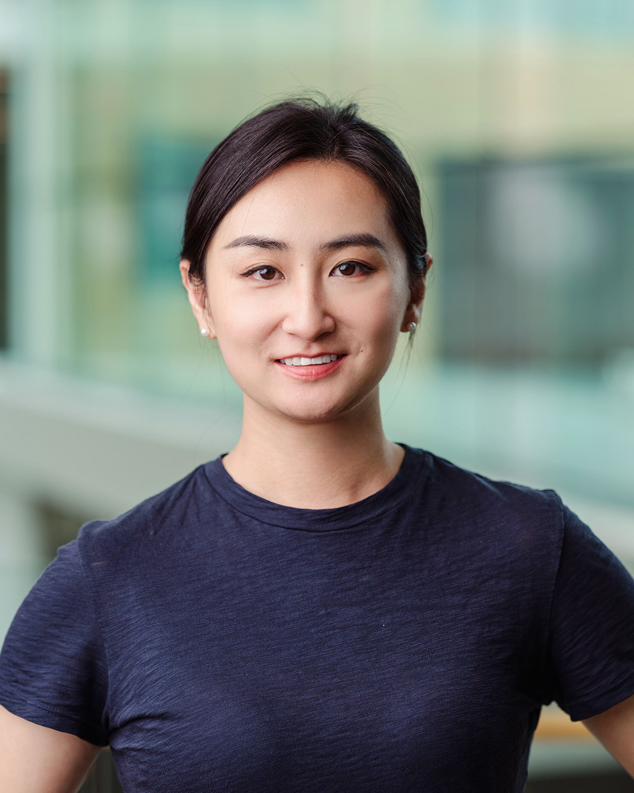
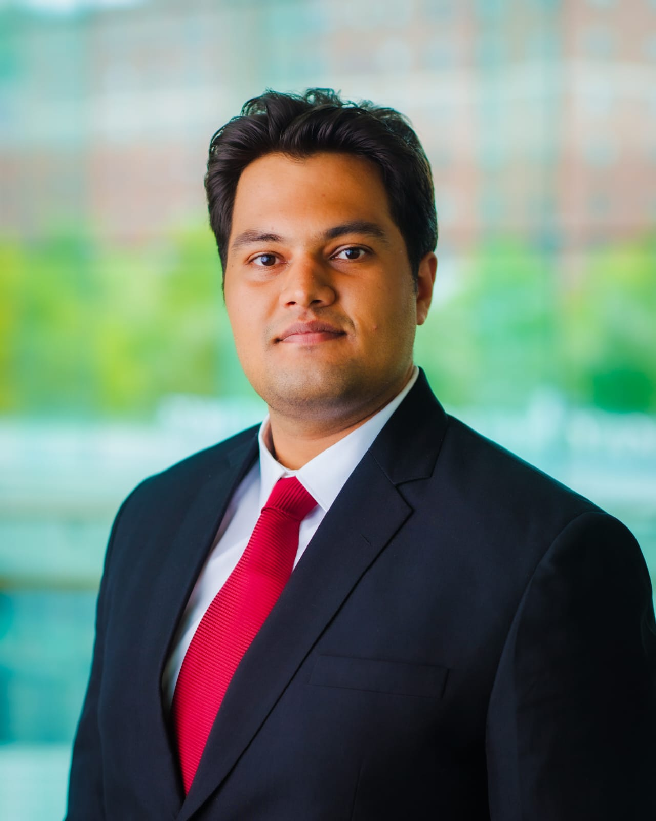
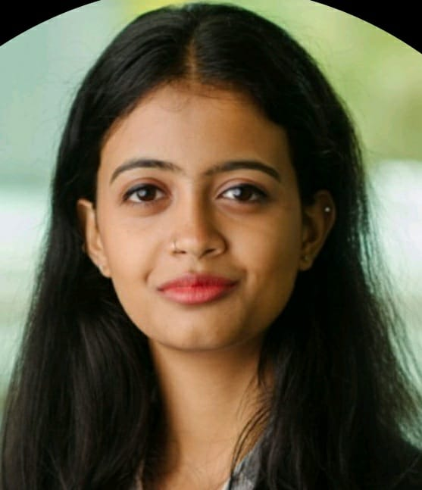
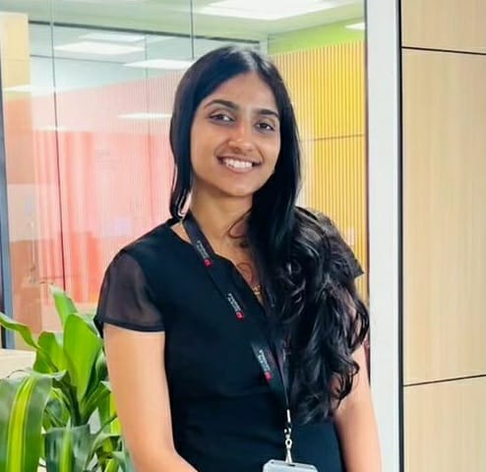
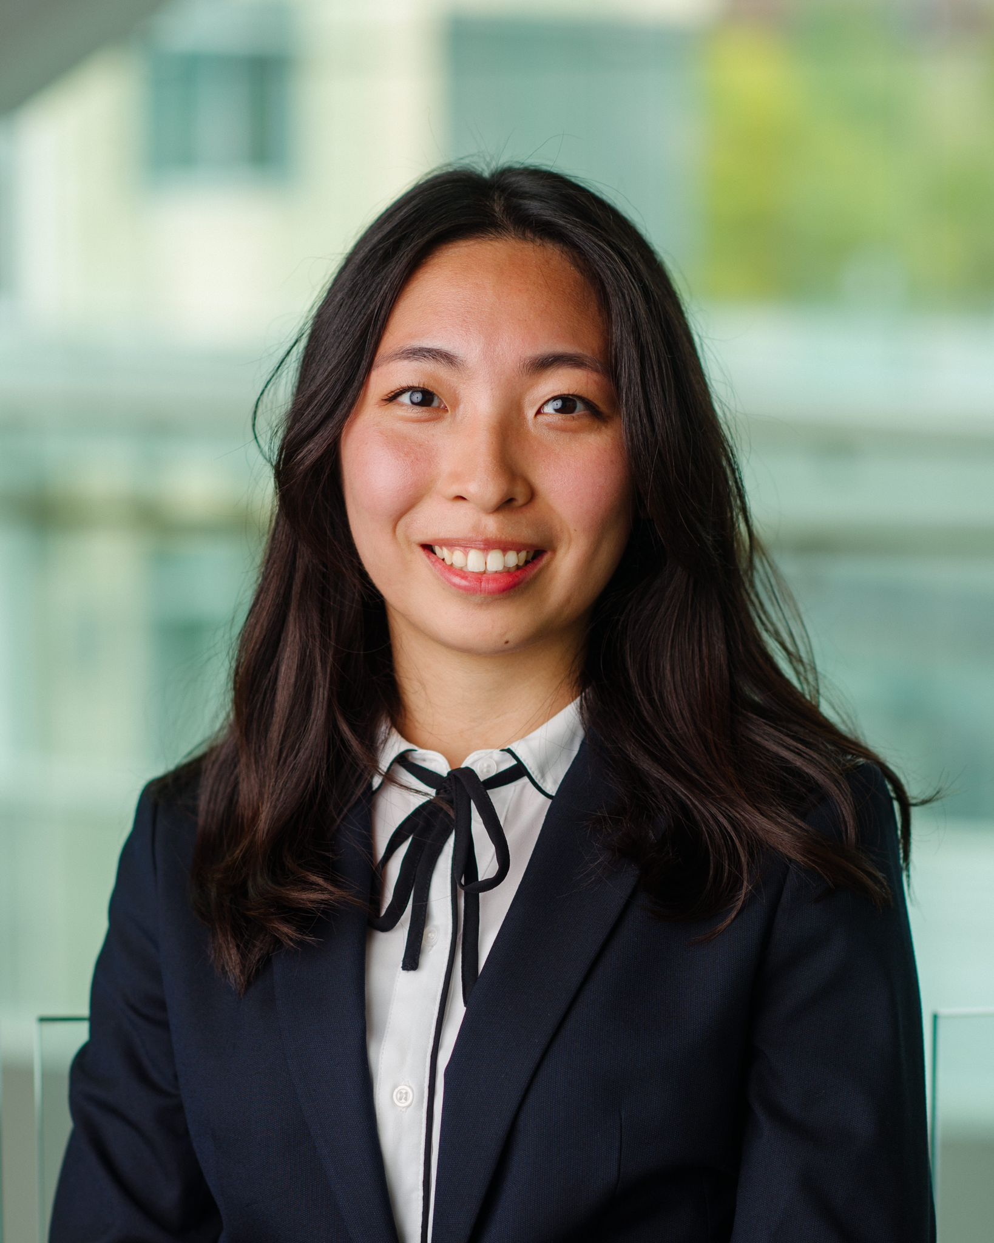

Team - LLM Linguabots
Evelyn (Xiaohuan) Wang
Kanishka Soni
Sherine George
Ning Ren
Amirthavalli Narayan
Morgan Maxwell
Wendy Kuo
Overview
Solution
Implementation
Future Scope
Problem Identification
Data Preparation
Manager

Slide 3

Content
01
Overview
02
Problem Introduction
03
Solution Statement
04
Design & Implementation
05
Challenges
06
Future Scope
07

Slide 4





Overview
01
Increasing heatwaves threaten global health.
LLM: Artificial neural network that use the input text and large datasets to deliver the deep understanding of knowledge.
Systems will build representative words and paragraphs from the massive amount of data.
02
03
LLMs will be customized for the desired domains and tasks to generate accurate response when the prompt is given.
“Conversational AI”, Chatbots leverage both the neural networks and transforms to understand and generate the human
–like contents.
04

Slide 5

Information Retrieval Challenges Survey for 30 MSBA Students
Have you experienced difficulties in locating information due to information overload? (Multi-options)
11 Career
11 Too much information, hard to filter
9 Tepper Resources
7 Academic-related
7 Life- related
2 I have questions, but have no time to figure out
2 All of the above
2 Others, eg. Just too tired
90%
Yes

Slide 6

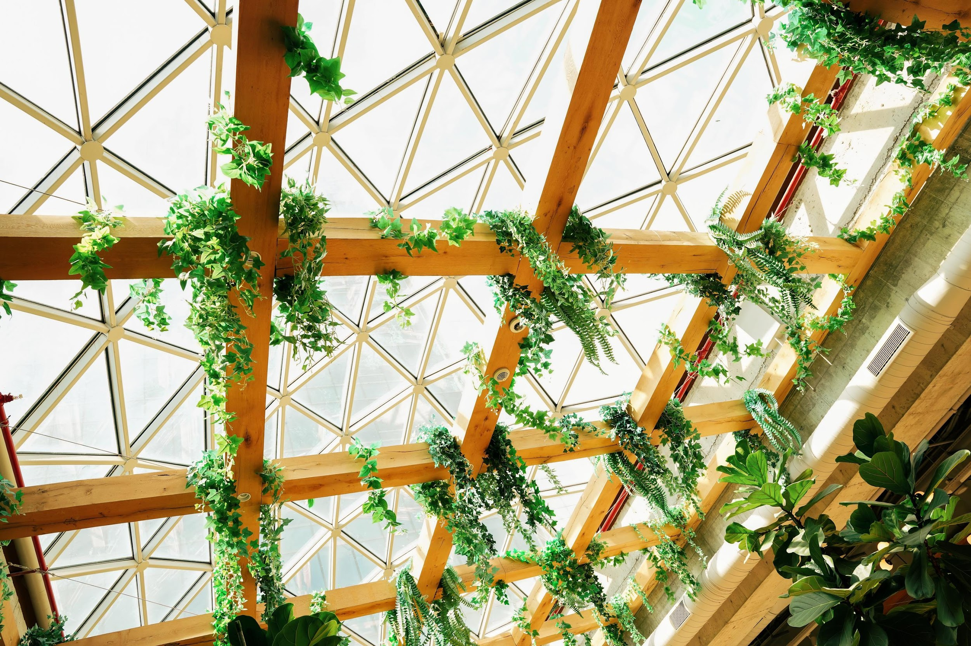




Problem Overview
Why we need the Tepper HelpBot?
Information Overload
Multiple Platform
Inefficient Retrieval
Confusion & Forgetfulness
Internal Stakeholder

Slide 7


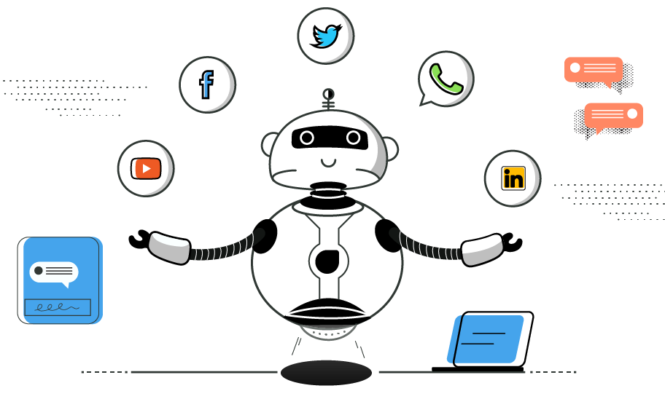


Solution
Key Features:
Unified Information Access
Understanding
24/7 Availability
Multilingual Support
Continuous Learning and Improvement
Benefits:
Reduced Cognitive Load
Time and Energy Savings
Enhanced Student Experience
Competitive Advantage

Slide 8
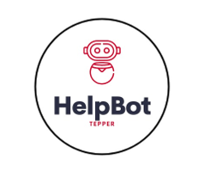
TEPPER HELPBOT
Functionalities
Bot to answer student queries
Summarizes text files
Help derive structure for assignments
Internal Stakeholder

Slide 9
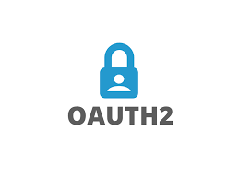
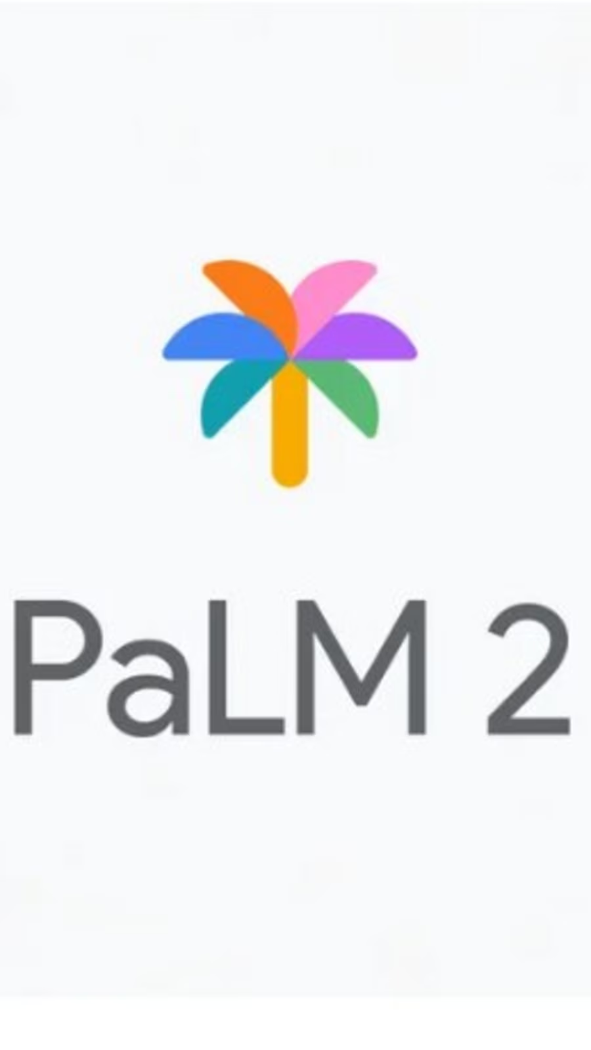
Design and Implementation
Step 1
Setup the OAuth Credentials
Requirements
PALM2 for the API response.
Streamlit to build the UI
OpenRouter to connect to various LLM models
LangChain to segment and combine data effectively
Step 2
Use PALM 2’s API to capture response
To Create our instance of PALM 2 and customize the UI as per requirement

Slide 10



Design and Implementation
CSV file
Requirements
PALM2 for the API response.
Streamlit to build the UI
OpenRouter to connect to various LLM models
LangChain to segment and combine data effectively
Step 1
Step 2
Step 3
Creating our custom dataset
Job to fine tune the model
Model is deployed and can be accessed through the website
To train the PALM 2 model on our custom data - Tepper data

Slide 11



Challenges
Multiple Platforms
Low Accuracy and Flexibility
Real Time Information
Canvas, Tepper website, Handshake, 12Twenty etc…
Insufficient data and time, insensitive to different word choice and languages
Delay in collecting and updating new data
Notes:
We are currently facing several key challenges in our project. First, integrating data from multiple platforms, such as Canvas, the Tepper website, handshake, and 12Twenty, is proving to be a complex task that requires a significant amount of coding effort. Second, during the initial phase, we have encountered issues with lower accuracy and flexibility, which we are actively working to improve. To create an effective chatbot that consolidates information and enhances efficiency, we also need to pay close attention to language sensitivity. Lastly, there are delays in obtaining real-time information, particularly related to career-related data. This delay could potentially lead to students missing out on valuable opportunities.

Slide 12
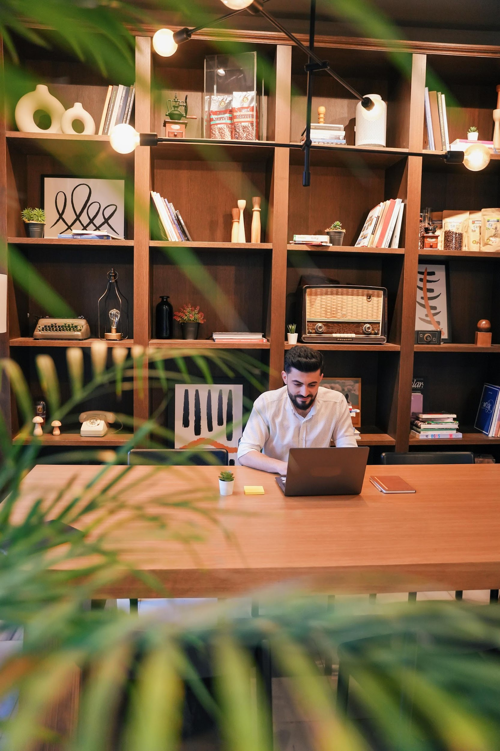
CMU Campus-Wide
HelpBot
Future Scope
Tepper HelpBot
Potential opportunities, advancements, and possibilities
Tepper MSBA HelpBot
Notes:
In terms of our project's future direction, our immediate goal is to tailor this Helpbot to serve Tepper MSBA students as a one-stop resource. As it evolves and becomes more advanced, our vision is to expand its capabilities to cater to both graduate and undergraduate students, recognizing the overlap in information needs. Looking further ahead, our ultimate objective is to develop it into a CMU-wide HelpBot.

Slide 13
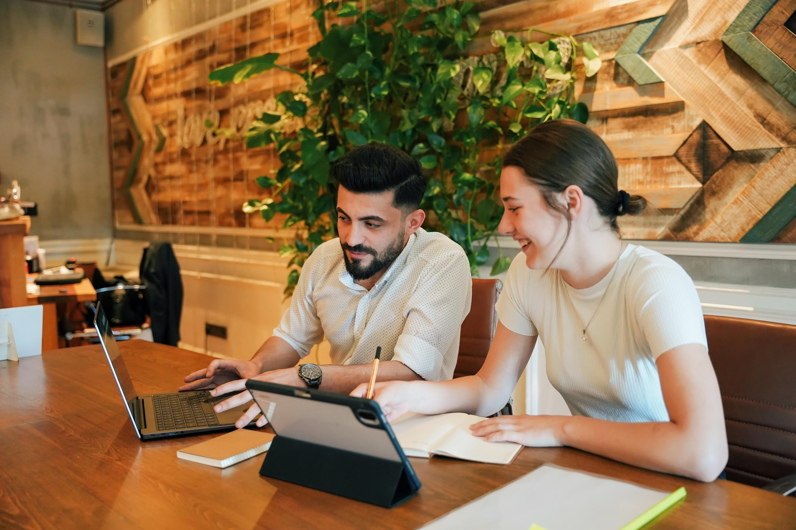
THANK YOU

